Slide 1

RECEPTION INDUCTION 2025/26
SAINT PATRICK’S CATHOLIC
PRIMARY SCHOOL
“Parents provide the seed, the school creates the tree. Saint Patrick’s do this very well; however, they do this with blossoms on!”
(Parent of children at St. Patrick’s)
“Parents, including those new to the school, appreciate the support and commitment leaders provide. One parent said, The school is a wonderful, happy environment and my children are thriving.”
(Ofsted 2022)
“Pupils are proud to attend St Patrick’s Catholic Primary School.”
(Ofsted 2022)
“Pupils’ behaviour is exemplary in the classroom and within prayer and liturgy. Pupils show a clear respect for each other and adults through the way they treat people with openness and friendship, hold doors open for others and speak with respect and politeness.”
(Denominational Inspection - 2025)
Notes:
Jennie

Slide 2

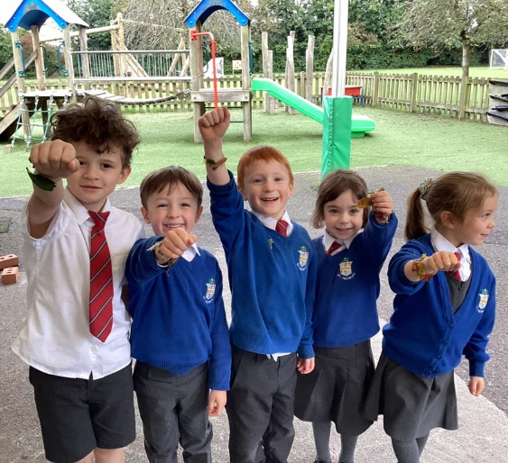
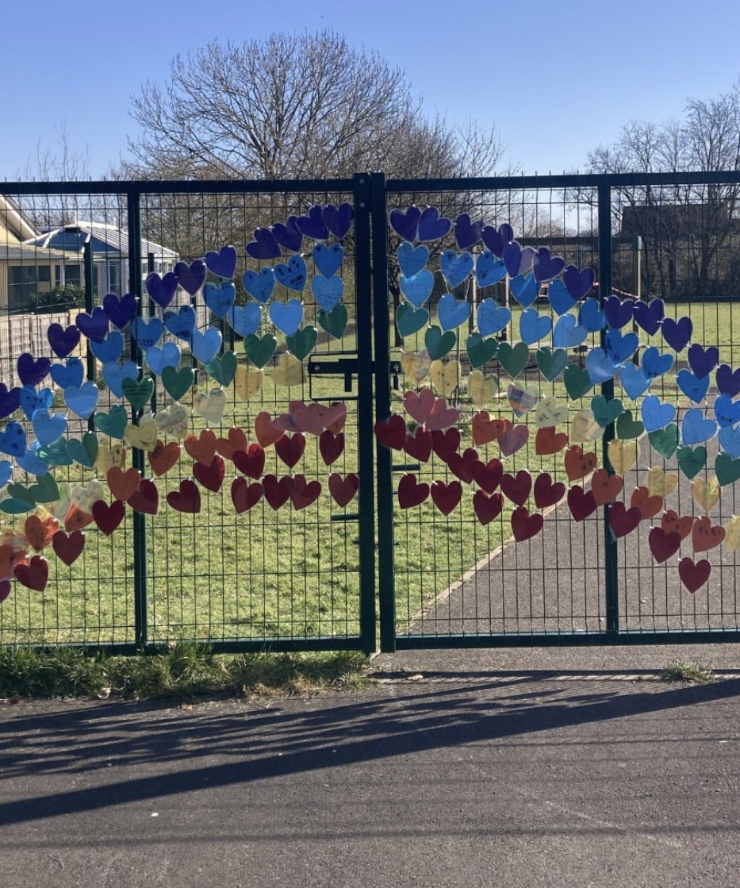
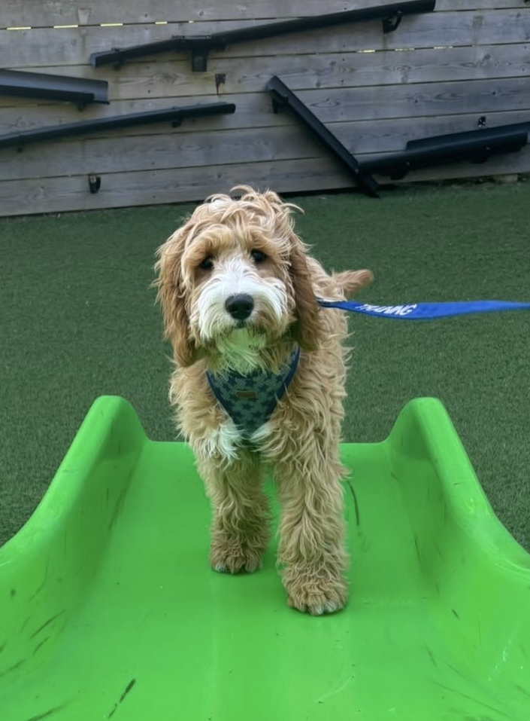
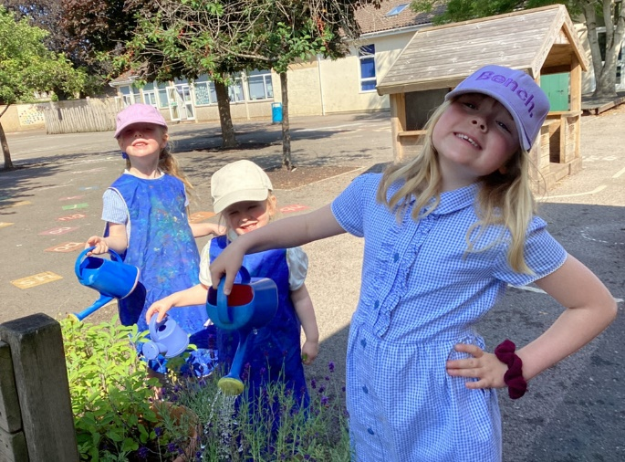
A Catholic Christian Community
Our Mission
To develop each individual child’s talents and potential in a caring Catholic community inspired by the teachings of Jesus Christ.
To Live, Love and Learn Like Jesus
Notes:
Jennie

Slide 3


Home School Partnership Agreement
The Home School Agreement is a contract which lasts for the next seven years.
It is a commitment between parents and the school to ensure that we forge a dynamic partnership in educating all of our pupils.
What does it look like in everyday terms?
Notes:
Jennie

Slide 4

Pastoral Support
AN INCLUSIVE…FAMILY…COMMUNITY
SCHOOL / PARISHES / COMMUNITY / HOME
Education of the whole child as a team
Communication - duty of care
Pastoral Care for your child
Our school is a DYNAMIC LIVING ORGANISM –
always growing, developing and seeking to better itself…
As a result, Saint Patrick’s seeks the active involvement, support and opinions of the members of its community.
“The school community has its foundations in the values of the Catholic faith. The school’s motto, ‘Live, Love and Learn Like Jesus,’ guides pupils every day.” OFSTED 2022
Notes:
Jennie

Slide 5
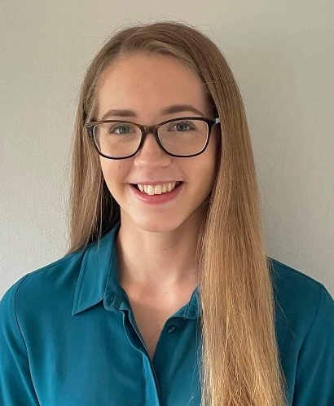
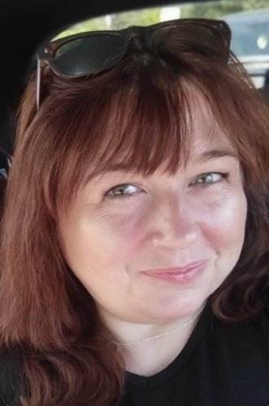
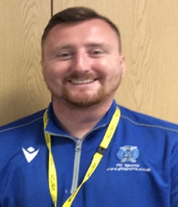
Early Years Team
Miss A Harding
Class Teacher
Mrs D Walls
Teaching Assistant
Mr P Andrews
PH ActiveEd
Notes:
Ariana

Slide 6
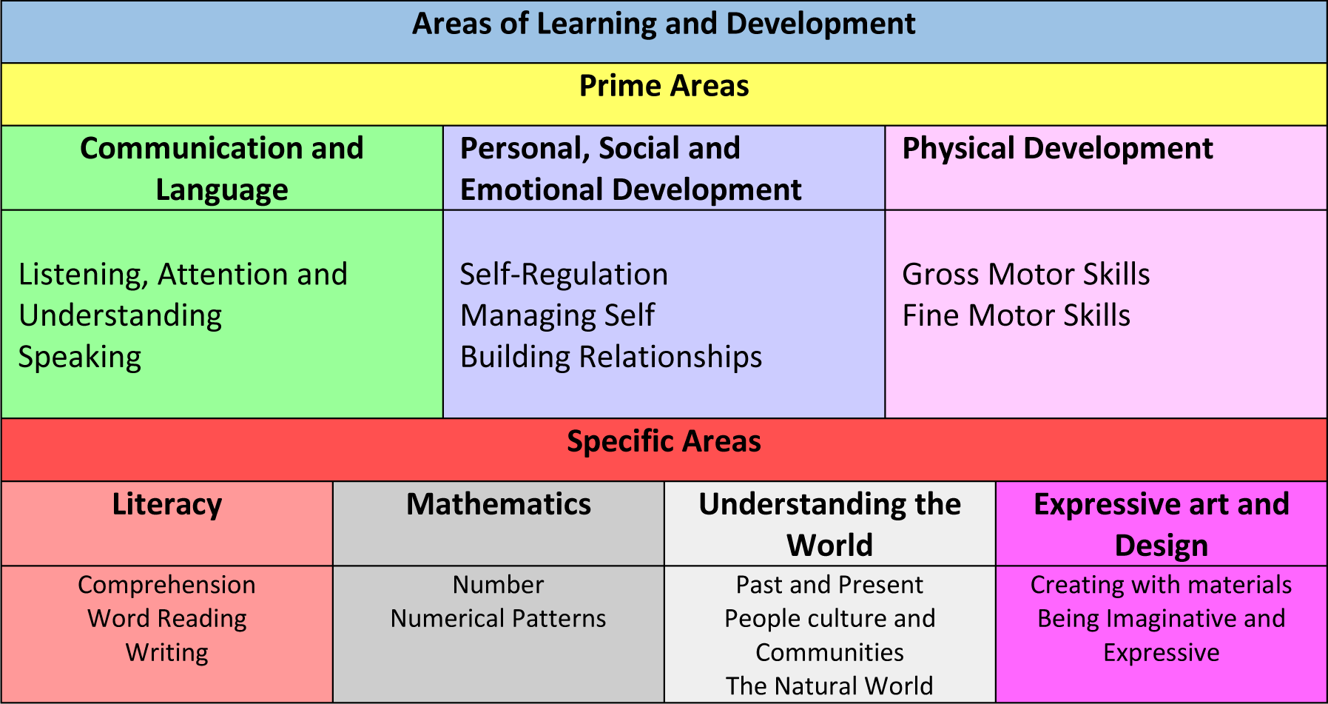
The Early Years Framework
The Early Years framework is designed for children aged 0 – 5.
Reception is the last stage in the Framework before Year 1 begins.
If you would like more information about the EYFS Framework, please visit the Gov.uk website.
Notes:
Ariana

Slide 7
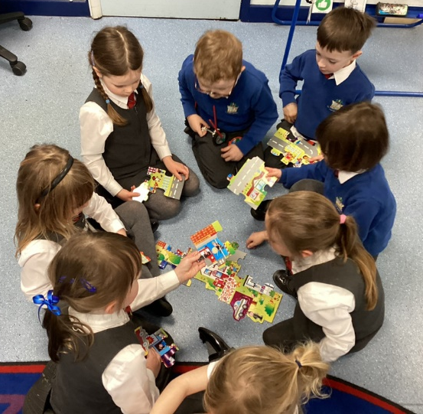
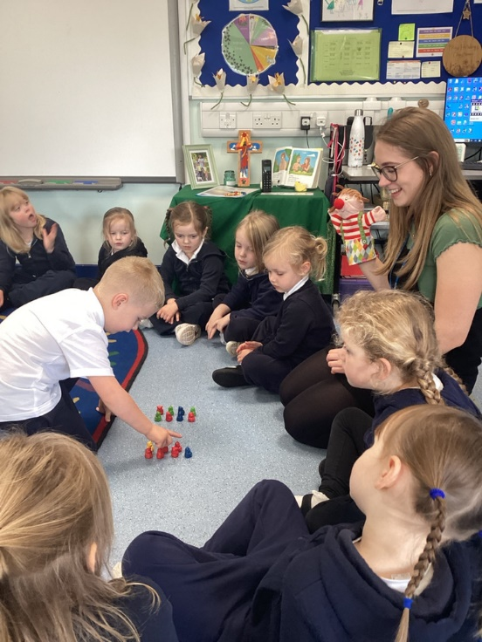
The Early Years Principles
Within the EYFS Framework, there are four main principles which guide all settings…
Every child is a unique child, who is constantly learning and can learn to be resilient, capable, confident and self-assured;
Children learn to be strong and independent through positive relationships;
Children learn and develop well in enabling environments with teaching and support from adults, who respond to their individual interests and needs and help them to build their learning over time. Children benefit from a strong partnership between practitioners and parents and/or carers;
Children develop and learn in different ways and at different rates. The framework covers the education and care of all children in Early Years provision, including children with Special Educational Needs and Disabilities (SEND) .
Notes:
Ariana – take this slide out next year?

Slide 8
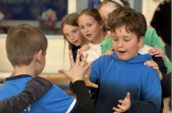
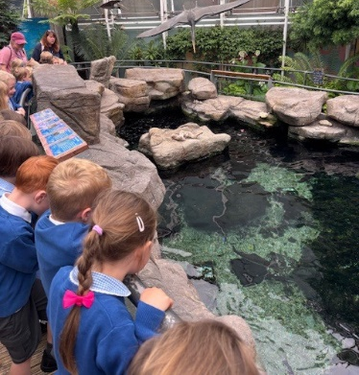
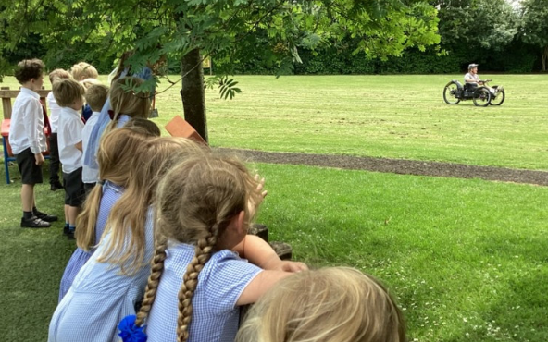
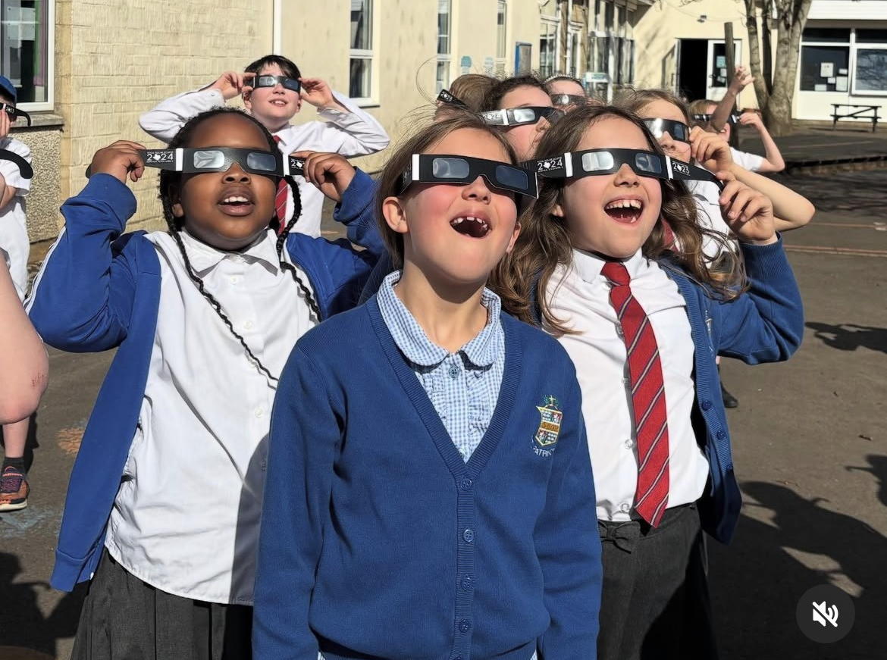
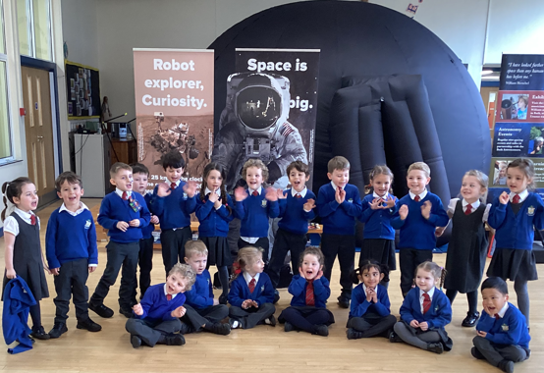
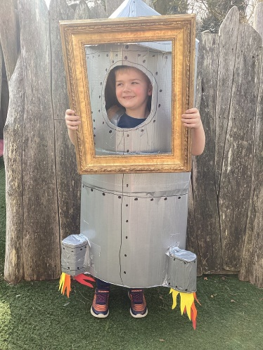
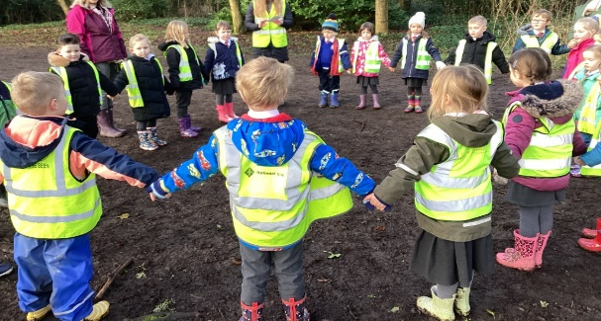
Curriculum Enrichments
Saint Patrick’s themed day
PE enrichment days
Charity work –collected food for the local food bank, fundraising for Tom Price
Saint Patrick’s Art Exhibition
STEM WEEK – working with Colchester Zoo and Bath Astronomers
World Book Day
School trips – Bristol Aquarium, Longleat, We The Curious, Bristol Zoo
KS1 and KS2 Pilgrimages
“The curriculum includes memorable experiences” OFSTED 2022
Notes:
Jennie

Slide 9
Induction Weeks
Your child’s induction…
Induction Weeks:
Week 1: Tuesday 2nd September to Friday 5th September - half days (8.40am -12:00)
Week 2: Monday 8th to Friday 12th September – half days including lunch (8.40am -1.10pm)
Week 3: Monday 15th September onwards – full days at school (8.40am – 3:15pm)
Notes:
Ariana

Slide 10
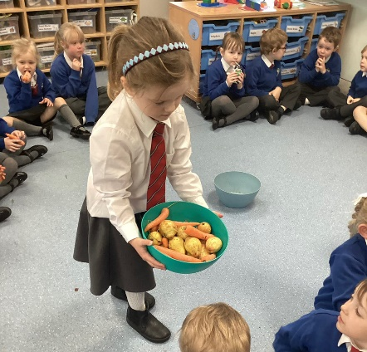

Lunch times –
UFSM / FSM explained!
ALL children in KS1 are entitled to UNIVERSAL FREE SCHOOL MEALS
Please fill out the form in the welcome pack if you think your child is eligible for free school meals (in addition to UFSM). ‘PUPIL PREMIUM’
Children having a school dinner will have a choice of three meals. Parents need to go on the school meals website to book school dinners.
Our new children sit together as a class at lunch. Our supervisors keep a special watch on all the new children to check that they are managing to eat their lunch.
Please ensure that you provide a lunch which your child will like to eat as we encourage everyone to eat as much of their lunch as possible.
Notes:
Jennie

Slide 11
Essential Information
Please label EVERYTHING your child brings to school.
Please let us know about any specific medical conditions your child may have. This is in addition to the information which you have supplied on the form.
Please send your child to school with a book bag and a lunch box / book hot dinners when staying for lunch. Each child will have their own locker where belongings will be stored.
http://www.coolmilk.com children will be given free milk until the age of 5. If you would like to continue with milk after 5 then please register a few weeks before their 5th birthday.
You will have your induction pack, please return forms to the school office by the end of this term. This PowerPoint will be available on the school website under Parent Information – New Starters.
School Uniform – Our supplier Michael Hope has advised us that any uniform orders placed over the summer will need to be done by Sunday 3rd August to ensure delivery in time for September (this date is for home deliveries).
Notes:
Ariana

Slide 12
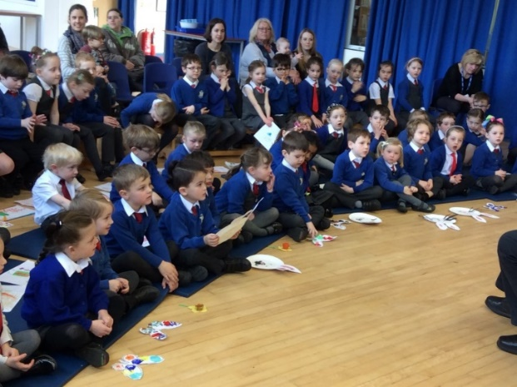
Developing Parent Partnerships at Saint Patrick’s
Provisional Meet and Greet sessions (during the 2 induction weeks)
Parents’ Evenings (October / March)
Annual Records of Achievement
Termly Assessment
Parent Information workshops
Learning Journals (Tapestry)
Informal conversation (morning/after school)
Notes:
Ariana

Slide 13


SAFEGUARDING
Keeping ALL our Children Safe
Register procedures
Absence
Medicine
Concerns
Use of Social Media
Confidentiality
Road Safety
Tolerance / Respect
Notes:
Jennie

Slide 14
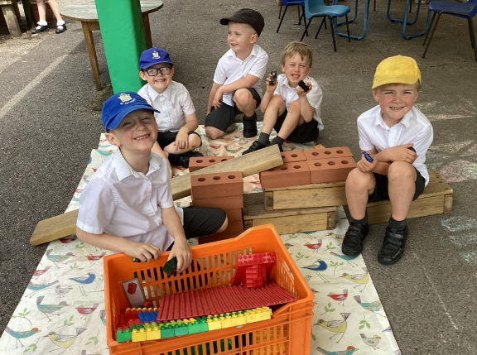
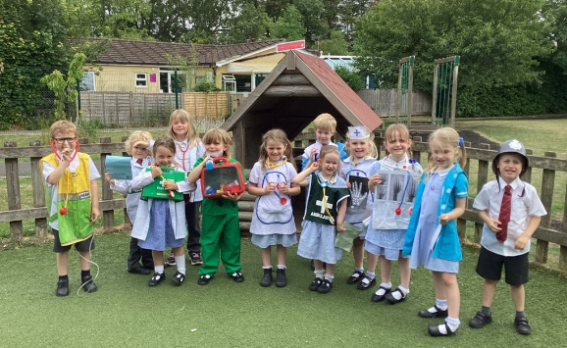
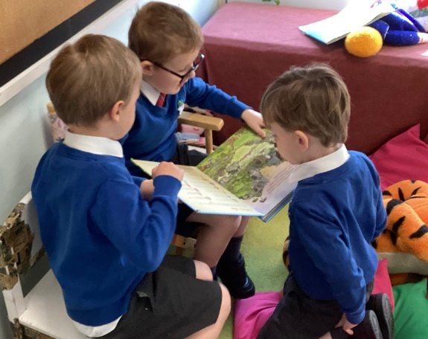
Preparing My Child for School
What can you do to help your child over the summer?
Enjoy books together and take trips to the library. Some great book are ‘Starting School’ by Janet Ahlberg, ‘I am too Absolutely Small for School’ by Lauren Child and ‘Harry and the Dinosaurs Go to School’ by Ian Whybrow and Adrian Reynolds.
Encourage your child to do as much for themselves as they can e.g. dress/undress independently, manage their toilet needs, using cutlery correctly, recognise their own name and begin to make their own choice.
Encourage lots of fine motor and gross motor activities.
Talk with your child about school, new and old friends and how they are feeling about starting school.
Notes:
Ariana

Slide 15

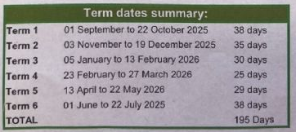
School Term Dates and
Day Closures
This year, all primary schools will hold 5 day closures in addition to the holiday dates when the school members of staff are engaged in staff training activities.
The following term dates are for your information:
The first day of the academic year for your child will be - Tuesday 2nd September (until 12 noon)
INSET DAYS FOR 2025-26
Monday 1st September 2025
Monday 5th January 2026
Monday 1st June 2026
Tuesday 2nd June 2026
Wednesday 3rd June 2026
Notes:
Jennie

Slide 16

On Reflection…
We are looking forward to a ‘super’ year ahead with you!
Please take a superhero pencil to start creating with, during the summer holiday.
Notes:
Jennie

