Slide 1
Meet the Teacher
The Team: Mrs Henry-Chapman, Mrs Garrett-Cervantes, Mrs Turner and Mrs Minty.
Thursday 26th September 2024

Slide 2
Who is Mrs H-C?
Qualified in 2021 with a PGCE from Bath Spa University and joined St. Patrick’s in September 2021.
I have experience teaching across both key stages as well as assisting in nursery school.
My hobbies include reading, music, world tv & cinema and travelling.
I have passion for The Arts, Maths and global issues.

Slide 3
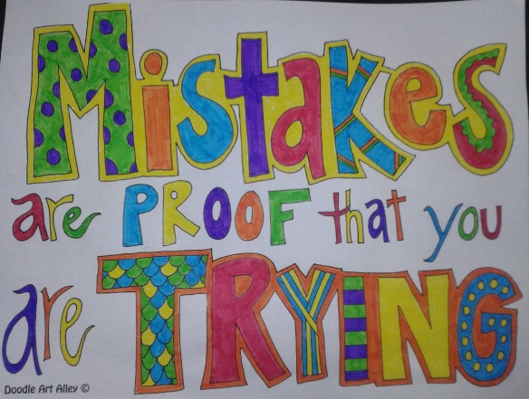
What makes a happy, effective learner?
A love of reading
Growing confidence – anxiety free workplace
Focus, concentration, personal and social skills
Opportunities for self-expression
Not being afraid to ask questions
A stimulating, interesting, helpful classroom
Not being afraid to ‘have a go’ or make mistakes
Not giving up

Slide 4





The Gem Project
Ruby: Supporting and listening to each other, giving praise.
Diamond: Problem solving, being responsible.
Emerald: Sticking with it, even when it gets tough. Knowing making mistakes is part of new learning.
Sapphire: Keeping focused. Ignoring distractions.
Topaz: Learning in a larger group.

Slide 5

A Curriculum of HOPE and
Agents of Change
This focuses on empowering children.
Children are encouraged to not just learn new skills but use them also.
Every other term there will be a ‘Religion Question’. This term’s question is : ‘How can I be a Gospel Activist?’
As part of this, this term we are thinking about :Who am I? Where do I come from? Who/What will I become? How can we make things better for others?

Slide 6
Assessment and Recording
We use a variety of summative and formative assessments to ensure every child makes progress along their personal learning journey.
Within the Stage that the pupils are working on we assess whether pupils are Working Below Expectations, Working towards expectations, Meeting Expectations, Exceeding Expectations
ATTAINMENT – It is not expected that pupils will be Meeting Expectations until the summer term, however, we will be able to report to you during the year whether or not your child is on track to meet expectations.
PROGRESS – This looks at each individual’s starting points. We strive to ensure that each child makes progress from their starting point over the year.

Slide 7
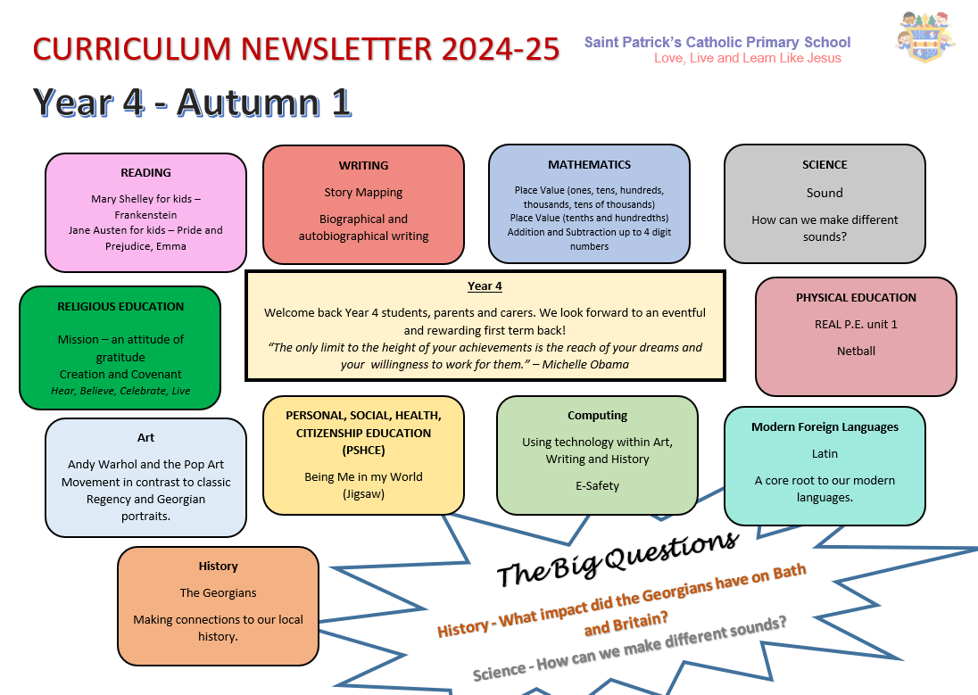
This is an overview of what we will be learning this term in Year 4
Our curriculum newsletter is updated every term and you can always find this on the school website under ‘Year 4’
There is also a key vocabulary section each term for each topic.

Slide 8

English Skills
Talk for writing
Oracy
Performance
Reading
- Decoding
- Comprehension
- Passion
Handwriting
- Formation
- Fluency
Spelling
Strategies
Phonics

Slide 9

Reading
Reading In School
Reading records need to be in school each day
Children will be heard once a week in Guided Reading sessions by the teacher.
There will be further opportunities throughout the week for them to be heard by an adult.
If your child needs their reading book changed, they will have opportunities to do so with an adult’s help.
Reading at home
Where possible, please listen to your child at least 3-4 times a week.
Please record any reading in the reading record (children can also write in these)
Please talk to your child about what they are reading- see questions on Reading Bookmarks
Developing a passion for reading is key!

Slide 10

Spelling and Handwriting
Spelling and Phonics
There are daily spelling lessons using our Essential Spellings scheme where the class will learn how to apply their phonics skills to become confident spellers.
Phonics interventions will be given to children who need additional phonics support.
Pupils are taught a variety of ways to practice and learn spellings (ideas will be included in Home Learning)
Weekly test will combine Yr3 and Yr4 Key Words and spelling patterns taught in class.
Handwriting
Pupils are working towards using a fluent joined style.
Our focus is to ensure everyone is forming letters correctly and sizing them correctly.
Please correct missing or unnecessary capitals.

Slide 11

Mathematics
This year we will continue to develop a mastery approach to mathematics, teaching topic areas in blocks to allow depth and fluency.
Pupils are encouraged to use number facts and develop their understanding by exploring numbers in lots of different contexts.
We are working with numbers up to 10,000. We are also teaching children more formal methods of recording.
How you can help:
It is increasingly important that pupils know ‘Key Instant Recall Facts’ (KIRFS)
    Practice using calculations, counting and sequencing numbers.
- Real- life opportunities for maths through using money, cooking etc.

Slide 12
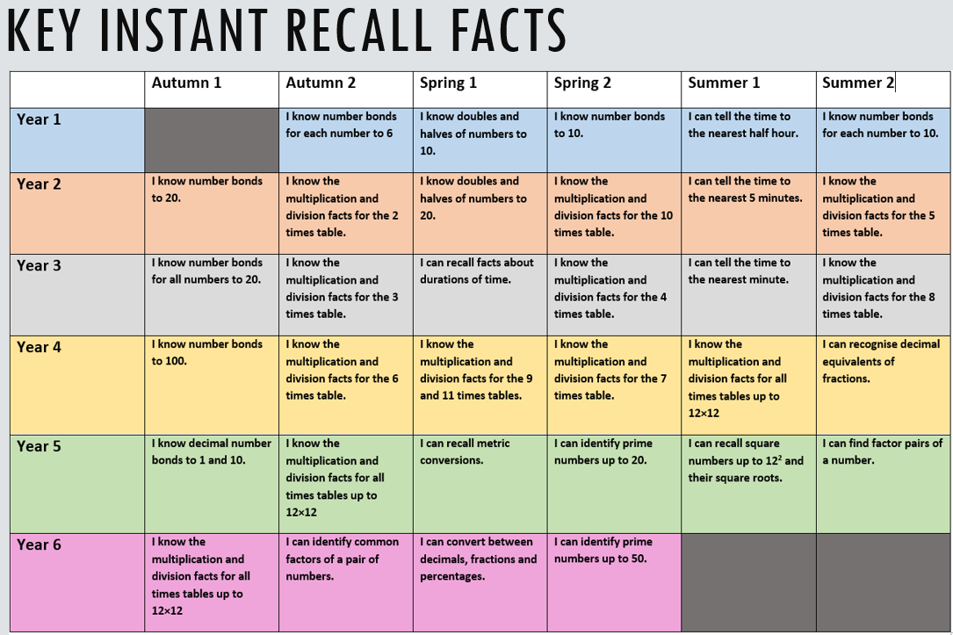

Slide 13
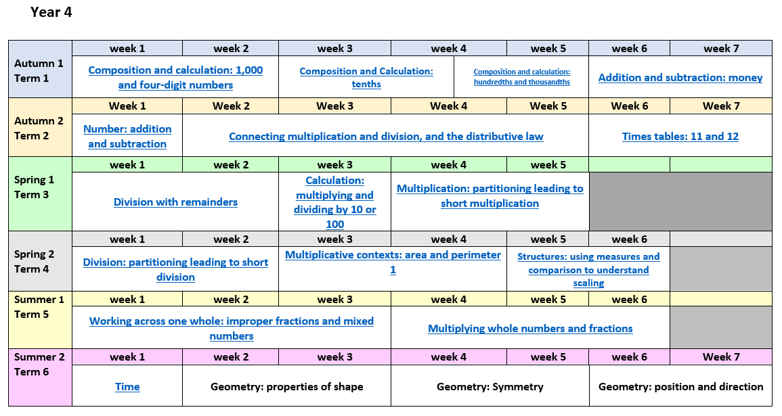
This is our annual overview for Maths
This may change throughout the year to meet the needs of the class.

Slide 14
Saint Patrick’s are in the ‘sustaining’ year of ‘Teaching for Mastery’ Programme
This is a 4 year programme developed by NCETM specialists and is guided by the following principles:
Coherence
Lessons are broken down into small connected steps that gradually unfold the concept, providing access for all children and leading to a generalisation of the concept and the ability to apply the concept to a range of contexts.
Representation and Structure
Representations used in lessons expose the mathematical structure being taught, the aim being that students can do the maths without recourse to the representation

Slide 15
Mathematical Thinking
If taught ideas are to be understood deeply, they must not merely be passively received but must be worked on by the student: thought about, reasoned with and discussed with others
Fluency
Quick and efficient recall of facts and procedures and the flexibility to move between different contexts and representations of mathematics. This is where you can help! Make sure your children know their number bonds to ten and twenty and any times tables set by the teacher. Children will be taught key facts in daily sessions which are in addition to the maths lessons.
Variation
Variation is twofold. It is firstly about how the teacher represents the concept being taught, often in more than one way, to draw attention to critical aspects, and to develop deep and holistic understanding. It is also about the sequencing of the episodes, activities and exercises used within a lesson and follow up practice, paying attention to what is kept the same and what changes, to connect the mathematics and draw attention to mathematical relationships and structure.

Slide 16
Multiplication Table Check (MTC)
This takes place in May/June 2024
Little and often – practice is key
Professor Assessor will be a great tool to practice timed questions
Typing skills – Dance Mat Typing:
https://www.bbc.co.uk/bitesize/topics/zf2f9j6/articles/z3c6tfr

Slide 17
Home Learning
GOOGLE CLASSROOMS
Home Learning will be given out on a Friday to be returned by the following Thursday. Please spend some time on these activities with your child.
Reading - Reading with an adult at least 3 days per week and independent reading at least 1 day per week. Please sign the record. Discuss the books characters, themes, plot and language style.
Spellings – To be given out on a Friday on the back of our weekly spelling test
Handwriting – To continue to work on basic letters and joins, to consolidate learning at school, working towards a fluent joined style – perfect to practice with spellings.
Number – There will be weekly times table practice as part of home learning. This will be in a variety of methods such as timed exercises or Professor Assessor
Enrichment – Each week there will be an optional enrichment activity, this will be linked to our learning and may help prepare your child for upcoming activities (such as double page spread research)

Slide 18
Important Information
PE every Monday and Wednesday for term 1 – St. Patrick’s PE uniform to be worn
We will be swimming in term 2 – keep an eye on school communication about this!
Please name all personal belongings.
Water bottles: Pupils are encouraged to drink water in class so please ensure they have their water bottle every day.
Parents Evenings: Tuesday 5th November and Thursday 7th November.
Please keep us updated if someone else is collecting your child.
If you have any questions or would like to arrange a meeting then please contact the office team.

Slide 19

Thank you for coming!
Any Questions?

