Slide 1

St Patrick’s Catholic Primary School
Meet the Teachers
Mrs Solomon and Miss Jones
Welcome to year 2
2024-2025
“Live, Love and Learn like Jesus”
Notes:
Miss Jones

Slide 2
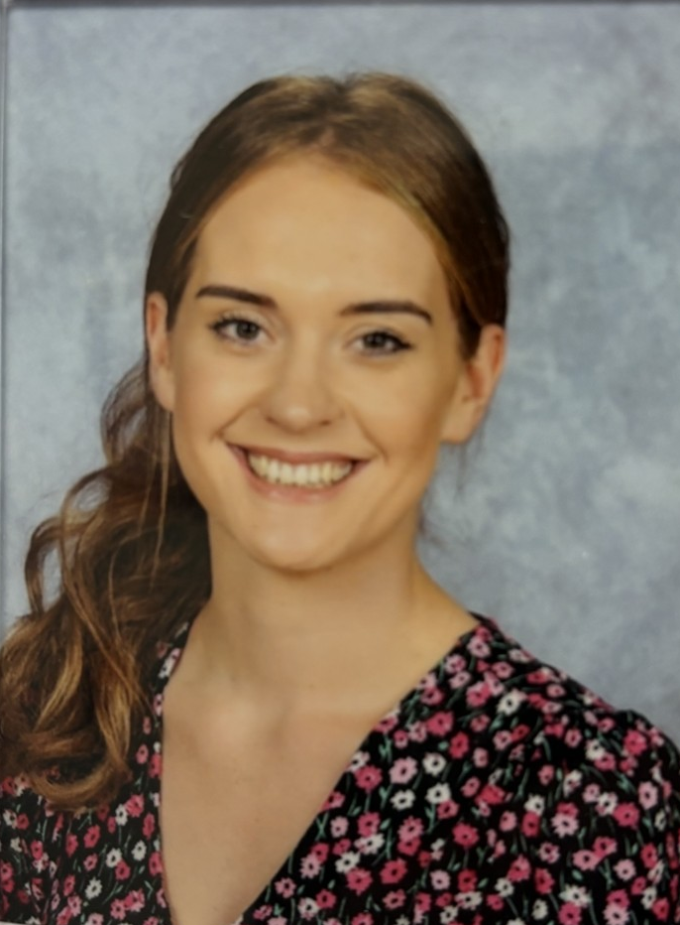
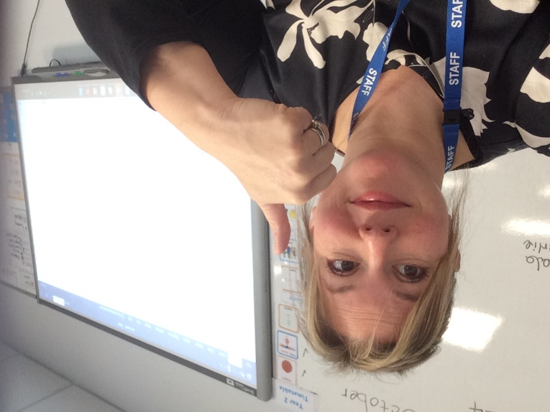
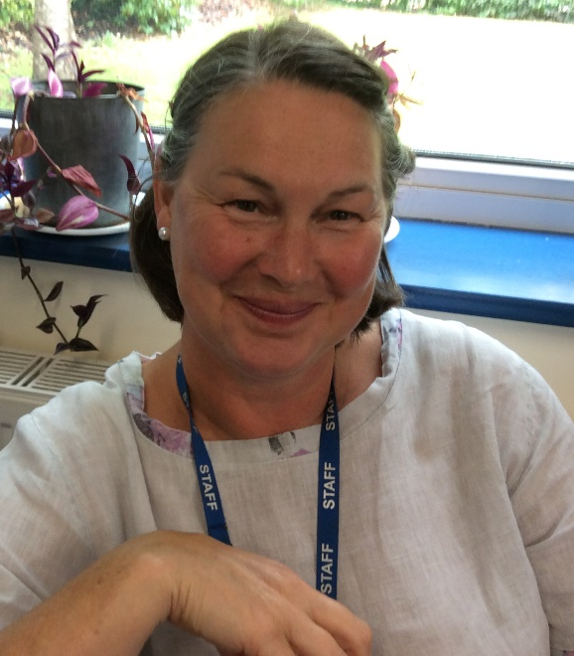
Our Wonderful Year 2 Team
Class Teacher
Miss Jones
Monday and Tuesday
Class Teacher
Mrs Solomon
Wednesday, Thursday and Friday
Support Staff
Mrs King
Monday - Friday
Notes:
Miss Jones

Slide 3
Here is an outline of what we will be teaching in the first term:
Maths – Place Value, Addition and Subtraction (0-100).
English – Writing autobiographies, plotting and planning new stories linked to The Jolly Postman.
  Grammar focus: conjunctions, writing questions and exclamation sentences.
Phonics – Recap of phase 5 (practising all of the alternative sounds, segmenting and blending).
Science - Growth and Survival.
Religion – Mission, Creation and Harvest as well as connecting to other faiths.
History – A walk through history (History of Corsham).
Art – Self Portraits.
PSHE – Jigsaw scheme ‘Me in my world’ and creating our own missions/classroom promises, etc.
P.E –Developing Ball Skills (sending and receiving) with our new PE Coaches.
Notes:
Miss Jones

Slide 4
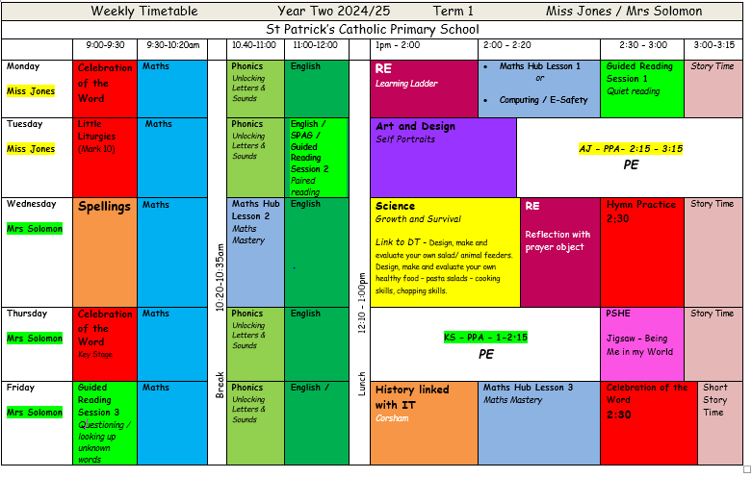
This is what it looks like, it is a big jump from Year 1!

Slide 5

Key Stage One:
End of year expectations/ targets for Year 2
Year 2 children are in the final year of Key Stage 1.
Each term the curriculum is planned in a way that will meet the needs of all pupils in our care.
We are supporting the children by supporting the transition from Year 1 to Year 2 and finding a balance between the 2 year groups.
Please see our class page for end of year expectations in Maths and English.
Please follow these links to learn more about the end of year expectations for English and Maths.
English - https://assets.publishing.service.gov.uk/government/uploads/system/uploads/attachment_data/file/335186/PRIMARY_national_curriculum_-_English_220714.pdf
Maths –
  https://assets.publishing.service.gov.uk/government/uploads/system/uploads/attachment_data/file/335158/PRIMARY_national_curriculum_-_Mathematics_220714.pdf
Notes:
Mrs solomon

Slide 6
Assessment and Recording
We use a variety of summative and formative assessments to ensure every
child makes progress along their personal learning journey. Within the Stage that the pupils are working on we assess whether pupils are:
Working Below Expectations, Working towards expectations, Meeting Expectations & Exceeding Expectations.
ATTAINMENT – It is not expected that pupils will be Meeting Expectations until summer term,
however, we will be able to report to you during the year whether or not your child is on track to meet expectations. All children are tested against the National Curriculum objectives. These tests will be in Reading and Maths – these are now not statutory but support our overall judgements. Writing will continue to be teacher assessed against national expectations.
If your child didn’t pass the phonics test in Year 1, they will be tested again in
June (and informally at various stages during the year).
PROGRESS – This looks at each individual’s starting points. Regardless of starting attainment and/or Stage, all children should move from one band (WB, WT, E, etc) to the next in a whole year. Progress is individual!
Each child learns and makes progress at different rates.
Notes:
Miss Solomon

Slide 7








Our English lessons are based on quality texts such as The Snail and the Whale by Julia Donaldson and The Jolly Postman by Janet and Allen Ahlberg.
We start each English sequence off by starting with a hook to engage the children and then use the book to pick out key features of the text, e.g. expanded noun phrases, questions, exclamation sentences, the use of nouns, verbs, adverbs, etc so that the children can create links and see how they are used in a familiar text. We have a different writing focus each term (fiction and non fiction) and will be writing for a range of purposes – keep an eye on the website curriculum page to find out what we are covering each term.
Notes:
Miss Jones

Slide 8


Reading
Reading Scheme:
Your child will be sent home a new reading book on a Monday. We ask that you build on their reading skills by rereading the book throughout the week – developing a fluent and confident reader. During read 1 the children will be focusing on basic understanding, decoding and predictions. It is during subsequent reads that your child can build on their understanding and fluency. It is your child’s responsibility to take their book home every day and return it the following day.
Children who move off the phonics reading scheme will become ‘free readers’. They will be encouraged to change their own reading book. Your child will need to let us know if they have finished their book as these may take longer to complete by the following Monday
Read for
Reading doesn’t always have to be the school book but can be own stories at home, menus, magazines, newspapers- anything that your child wants to read. Our first aim is to generate a passion for reading! There are lots of tips and reading suggestions on our class page.
Tips and Hints
Encourage him/her to sound it out and then blend the sounds together to make the word. When they are more confident suggest they try and sound out in their head and if they know the word just say it! When reading a sentence with sounding out, get them to reread for fluency.
Use a finger or a pointer to follow the words.
Discuss the picture in context to the sentence – can they spot any extra information from the illustration.
Notes:
Miss JOnes

Slide 9
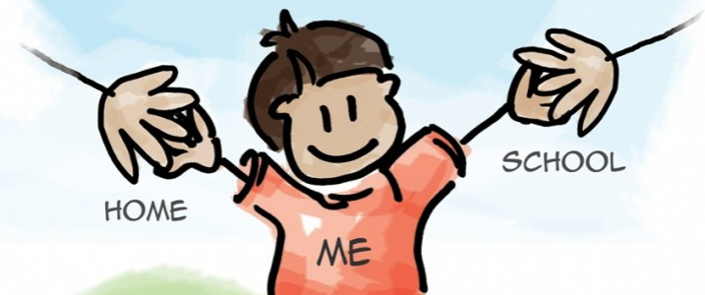
Reading: Parent Partnership
Things you can do at home
As part of your reading time, talk about the book. Ask questions to develop understanding and extract information.
Explain the importance of re-reading the story book your child has.
Talk about new words and what they mean.
Share lots of different types of books – non-fiction, poetry and stories.
Look all around for opportunities to read for information.
Join/ visit the library, look out for special events at the library ….
Do anything that encourages your child to read and makes reading fun!
We will upload a list of comprehension questions onto GC that you can ask your child when reading together.
Notes:
Miss Jones

Slide 10

Guided Reading:
To use a range of strategies to read new words (blending, segmenting, picture clues, context).
To select and retrieve information (to be able to answer questions).
To be able to interpret events and information using evidence from the text (use of inference).
To give opinions about the text with reasons.
To comment on language choices, patterns in words, general features of a text, how the book is set out.
To be able to predict what might happen in a story and retell the story.
We have a range of reading opportunities to help children develop a passion for reading (library visits, end of day chapter book, guided reading and reading within English lesson as well as free time reading).
Notes:
Mrs Solomon

Slide 11
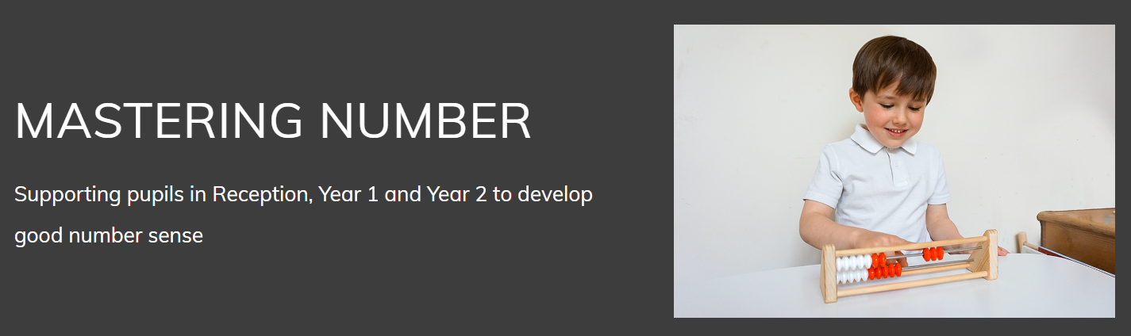
This project aims to secure firm foundations in the development of good number sense for all children from Reception through to Year 1 and Year 2. The aim over time is that children will leave KS1 with fluency in calculation and a confidence and flexibility with number. Attention will be given to key knowledge and understanding needed in Reception classes, and progression through KS1 to support success in the future.
Notes:
Mrs Solomon

Slide 12
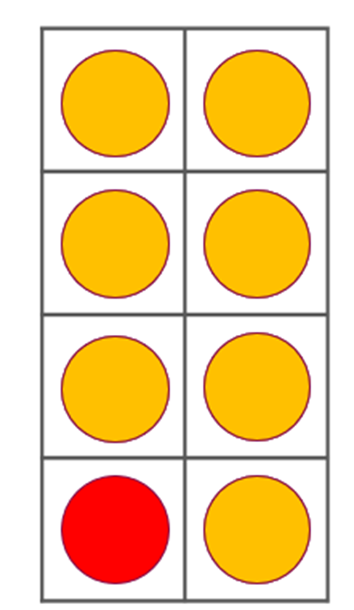
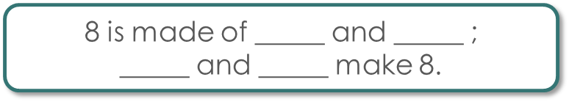

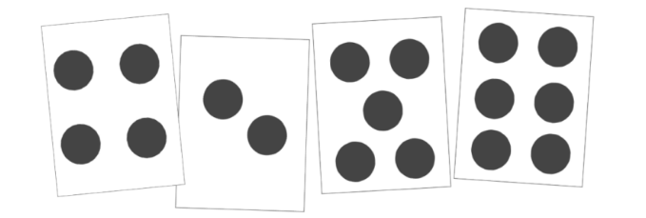
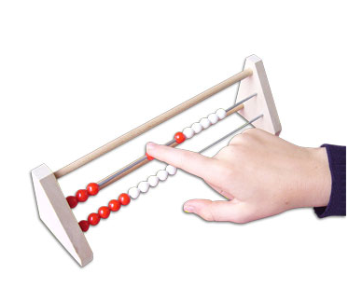

Mastering Number
Just as we have stand alone daily Phonics sessions we also have a daily Mastering Number Session.
This is a daily scheme taken from The National Centre For Excellence In The Teaching OF Mathematics. It aims to give the children a solid ‘number sense’.
By this we mean being able to visualise numbers better, being able to ‘Subitise’.
To subitise is to identify the number of things in a set simply by quickly looking at them—not by counting them one by one.
For example -
Two!
Rekenreks
Notes:
Mrs Solomon

Slide 13
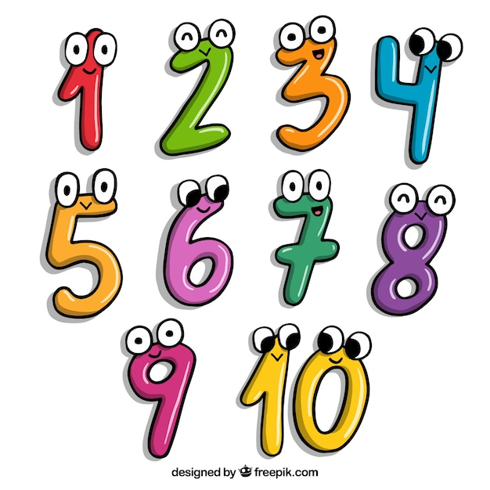
Maths: Parent Partnership
Learning is a partnership and one of the great ways you can help is by assisting the children to learn first of all the pairs of numbers that make 20 and possibly to make a hundred. 14,6 8,12 13,7 >>>>> 30 +70 35 and 65
Telling the time is also something that you can particularly help with at home. O’clock, half past, quarter past then quarter to the hour. You will need an analogue clock!
We will be starting Times Tables this year-2x, 5x and 10x in Year 2 (3x and 4x to follow on).
In the parent pack there is an addition grid of Y1 and Y2 addition facts for the children to learn off by heart.
Notes:
Mrs Solomon

Slide 14

Spellings: Parent partnership
Spellings are linked to our Phonics lessons or they are from vocabulary lists related to our topics.
Find out which of the spellings your child already knows.
Practise writing the spellings in sentences as this helps your child to transfer the knowledge into their everyday writing.
We are working with the children so that they know the top 100 words and are able to spell them by the end of Y2.
Non negotiables
Thank you!
Notes:
Mrs Solomon

Slide 15


Home Learning
We hope that you will continue to read regularly with your child and help them to learn their spellings. In addition, we will sometimes add maths activities (eg learning number bonds to 20, 2x, 5x and 10x tables (later in the year) on Professor Assessor), handwriting sheets or topic related activities.
We hope this will consolidate what we have been learning in school especially in reading and spelling each week – it’s definitely a partnership!
Your support and interest will help the children to embed their learning and the more practice of reading, spellings and tables that they can enjoy, the more they will learn.
The work will be given out/put on Google Classrooms on a Wednesday, to be returned by the following Wednesday when we will do our regular spelling test.
Notes:
Mrs Solomon

Slide 16

SAFEGUARDING
Keeping ALL our Children Safe
Register procedures
Absence
Medicine
Concerns
Use of Social Media
Confidentiality
Changes to collection
Notes:
Miss Jones

Slide 17
Other Information
Named clothing
Absence
Marvellous Marbles
Handwriting
Communicating with Mrs Solomon/ Miss Jones
Regular hand washing and/or sanitising.
PE kits to be worn on Tuesday and Thursday.
Please remember to send in water bottles and to label them.
Notes:
Miss Jones

Slide 18

If you have any questions or concerns at any point during the year, please CONTACT US STRAIGHT AWAY!
Thank you very much for joining us ☺
Notes:
Mrs Jones

